Slide 1

Developing Technical Software
Week 2:
Revisit Technical Programming –
Structured programming with functions: passing parameters by value and by reference

Slide 2

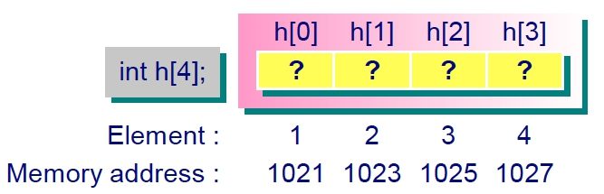
Recall: Arrays & Pointers
An array is a collection of variables of the same type.
When an array is declared, n consecutive memory locations are
allocated by the compiler (index range from 0 to n-1).
int h[4];
1020
1024
1028
1032
The array name is a constant pointer to the first element of the array.
Pointers can be subscripted like array. For the above example, if we
have hPtr=h, then hPtr[1] refers to the array element h[1].
© Swinburne University of Technology
3

Slide 3
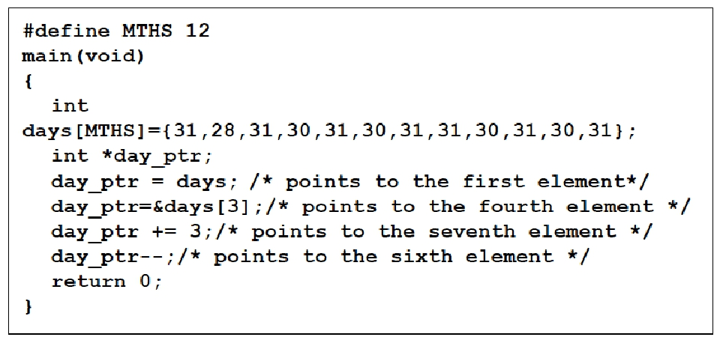
Pointers and arrays
© Swinburne University of Technology
3

Slide 4
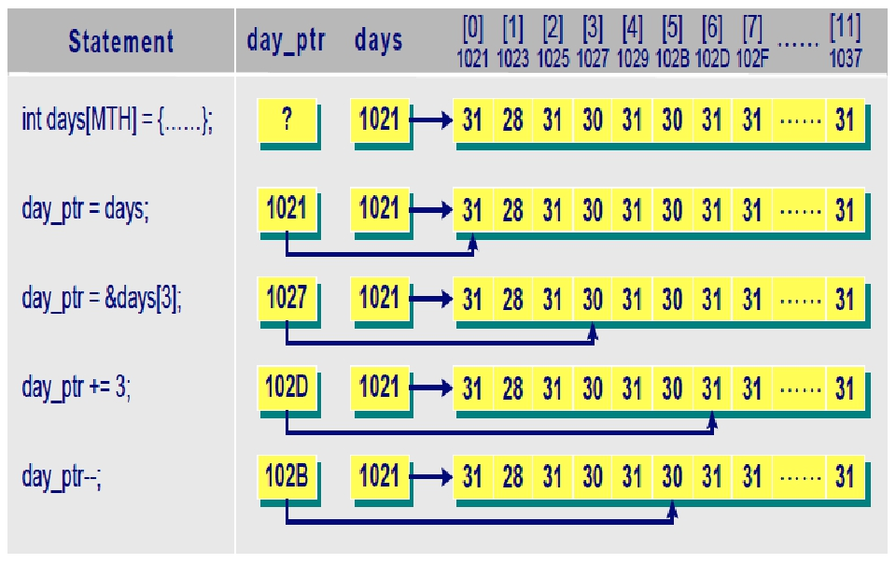
4

Slide 5
Recall: Arrays & Pointers
1020
1024
1028
1032
For an element in an array h[i] at index i, we can retrieve the address of a particular element in the memory using either
&h[i] or simply (h+i)
The value of the array h[i] at index i can be retrieved using
h[i] or *(h+i)
Never use * in front of array to dereference - *h[i]
© Swinburne University of Technology
3

Slide 6
Expected Output?
#include <stdio.h>
int main()
{
int A[5] = {10, 4, 5, 8, 1};
int i;
for(i=0; i<5; i++)
{
printf("The address is %d \n", &A[0]);//Prints the address of respective element of the array
printf("The address is %d \n", A+i);//Prints the address of respective element of the array
printf("The value is %d\n", A[i]);//Prints the value of the respective address of the element
printf("The value is %d \n", *(A+i));//Prints the value of the respective address of the element
}
return 0;
}
© Swinburne University of Technology
2

Slide 7
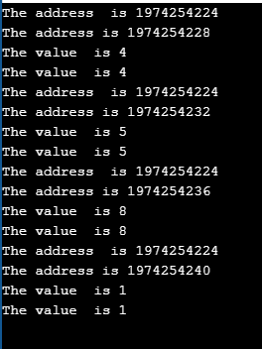
Expected Output?
#include <stdio.h>
int main()
{
int A[5] = {10, 4, 5, 8, 1};
int i;
for(i=0; i<5; i++)
{
printf("The address is %d \n", &A[0]);//Prints the address of the respective element of the array
printf("The address is %d \n", A+i);//Prints the address of the respective element of the array
printf("The value is %d\n", A[i]);//Prints the value of the respective address of the element
printf("The value is %d \n", *(A+i));//Prints the value of the respective address of the element
}
return 0;
}
© Swinburne University of Technology
2

Slide 8
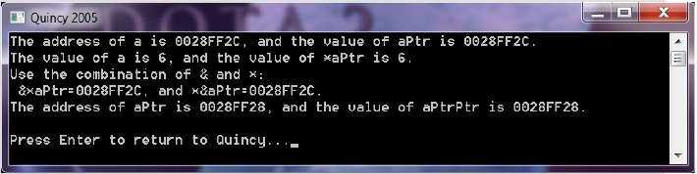
Expected Output?
#include <stdio.h>
int main()
{
int a, *aPtr;
int **aPtrPtr;
a=6;
aPtr=&a;
aPtrPtr=&aPtr;
printf("The address of a is %p, and the value of aPtr is %p.\n",
&a, aPtr);
printf("The value of a is %d, and the value of *aPtr is %d.\n",
a, *aPtr);
printf("Use the combination of & and *:\n &*aPtr=%p, and
*&aPtr=%p.\n", &*aPtr, *&aPtr);
printf("The address of aPtr is %p, and the value of aPtrPtr is
%p.\n", &aPtr, aPtrPtr);
return 0;
}
© Swinburne University of Technology
2

Slide 9
Programmer-Defined Functions
Example
#include <stdio.h>
float pi (void); /* function prototype */
int main ( )
{
  float p;
  p = pi( );
  printf(“The value of pi is %f \n”, p);
  return 0;
}
float pi (void)
{
return 3.141593;
}
The value of pi is
3.141593
■ A function returns a value except a void function.
9
© Swinburne University of Technology

Slide 10
Programmer-Defined Functions
Function Prototype
float pi (void);
It informs the compiler that the main function will reference a function named pi
Function Definition
return_type func_name(para_declarations)
{
statements;
return 3.141593;
}
float pi (void)
{
return 3.141593;
}
  p = pi( );
Function Call
The execution of a program always begins with the main function. The programmer-defined function is called when the program encounters the function name pi
10
© Swinburne University of Technology

Slide 11
Recursion
A recursive function is a function that calls itself either
directly or indirectly through another function.
We may consider solving a problem by recursive function
call if
  The simplest case of the problem could be easily solved (base case)
  The problem could be represented by a similar but simpler version of
  the original problem (recursive call)
Example: Recursively calculating factorials
long fact(int n)
{
if (n<=1) return 1;
else return (n*fact(n-1));
}
© Swinburne University of Technology
11

Slide 12
With vs. Without programmer-defined function
Example: Find the maximum number of three integers
#include <stdio.h>
int max(int, int);
int main( )
{ int a, b, c;
printf(”Input three integers \n”);
scanf(“%d%d%d”,&a,&b,&c);
printf(“The maximum number is:”);
printf(“%d”,max(max(a,b),max(a,c)))
return 0;
}
int max(int x, int y)
{
if (x >= y) return x;
else return y;
}
#include <stdio.h>
int main( )
{int a, b, c, max;
printf(”Input three integers \n”);
scanf(“%d%d%d”,&a,&b,&c);
if (a > b && a > c)
max = a;
else if (b > c && b > a)
max = b;
else
max = c;
printf(“The maximum is: %d”,max);
return 0;
}
With programmer-defined function
Without programmer-defined function
© Swinburne University of Technology
12

Slide 13
Pass parameter(s) to the function
Suppose we hope the function pi returns an integer multiple of the value π
(e.g., 2π ), the multiplier could be specified by a parameter as follows:
Example
#include <stdio.h>
float pi(int);
int main( )
{
  float p;
  p = pi(2);
  printf(“The value of two pi is %f \n”, p);
  return 0;
}
float pi(int n)
{
return 3.141593*n;
}
The value of two pi is
6.283186
13

Slide 14
Local Variables
Local variables are defined within a function, thus include the formal parameters and any other variables declared in the function. In the example result, a, b inside the main function are local variables
Local variables can be accessed only in the function that defines them.
A local variable has a value when its function is being executed, but its value is not retained when the function is completed.
© Swinburne University of Technology
14

Slide 15
Global Variables
Global variables are defined outside the main function or other programmer-defined functions. In example a, b are global variables.
Global variables can be accessed by any function within the program.
© Swinburne University of Technology
15

Slide 16
Global variables and Local variables
#include <stdio.h>
//Global variables
int a;
int b;
int add();
{
return a+b;
}
int main( )
{
int result; //Local variables
a = 5, b = 7;
result = add();
printf(“%d\n”, result);
return 0;
}
© Swinburne University of Technology
16

Slide 17
Calling functions by value and
by reference
Call by value: the formal parameter holds a copy of
the actual parameter. Therefore, changes to the formal
parameter in a function is done on the copy, not the
actual parameter.
Call by reference: the formal parameter holds the
address of the actual parameter, i.e., the formal
parameter is a pointer. Therefore, changes to the
value pointed to by the formal parameter changes
the actual parameter instantly.
 Swinburne University of Technology
17

Slide 18
Example: Parameter pass by value
2^8
#include <stdio.h>
int power(int, int);
int main( )
{ int a, b, c;
a=2;
b=8;
c=power(a,b);
printf("The value of c is
%3d", c);
return 0;
}
int power(int x, int n)
{ int p;
for (p=1; n>0; n--)
p=p*x;
return p;
}
int power(int x, int n)
{
int p;
for (p=1; n>0; n--)
p =p*x;
return p;
}
The value of n is altered within the function.
but this does not change the value of b in the main body of the C program.
Such a parameter passing method is called “pass by value”.
© Swinburne University of Technology
18

Slide 19
Parameter List
#include <stdio.h>
int power(int, int);
int main( )
{ int a, b, c;
a=2;
b=8;
c=power(a,b);
printf("The value of c is
%3d", c);
return 0;
}
int power(int x, int n)
{ int p;
for (p=1; n>0; n--)
p=p*x;
return p;
}
The parameters n, x required by the function are called
formal parameters, while a, b are actual parameters.
The formal parameters and actual parameters must match number, type, and order.
In the function call power(a,b), the values in actual parameters are copied to the formal parameters, thus the values of actual parameters are not altered by the function.
© Swinburne University of Technology
19

Slide 20
Another example for function call by value
Example
#include <stdio.h>
int add1(int);
int main( )
{
int num = 5;
num = add1(num);
printf(“The value of num is: %d”, num);
return 0;
}
int add1(int value)
{
return ++value;
}
 Swinburne University of Technology
20

Slide 21
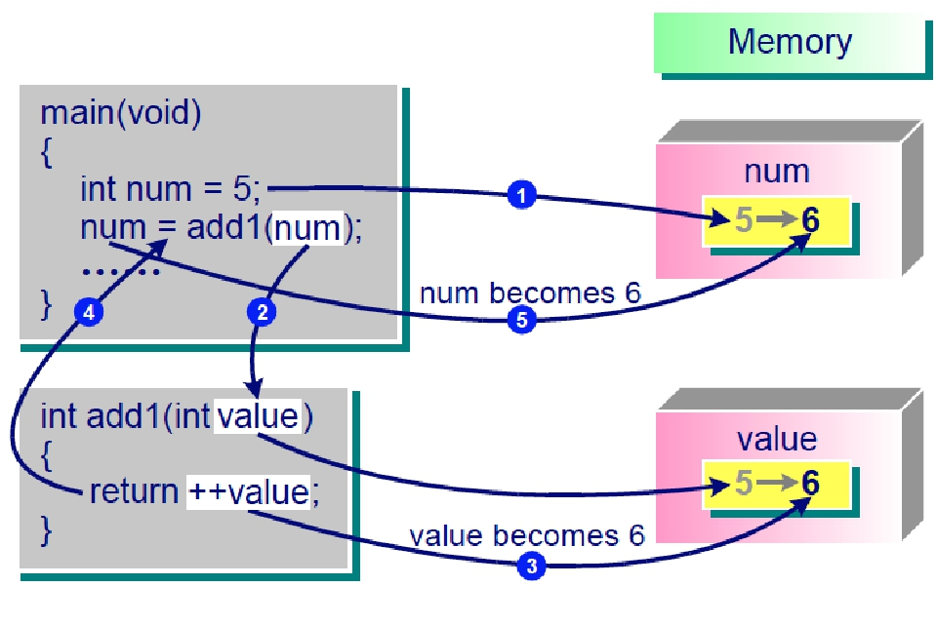
21

Slide 22
#include<stdio.h> int sum(int a)
{ a = a+100;
} int main()
{ int a=100; sum(a); printf("%d",a);
}
100
200
0
Error

Slide 23
#include<stdio.h> int sum(int a); int main()
{ int a=100; sum(a); printf("%d",a);
} int sum(int a)
{ return a = a+100;
}
100
200
0
Error

Slide 24
#include<stdio.h> int sum(int a); int main()
{ int a=100; a=sum(a); printf("%d",a);
} int sum(int a)
{ a = a+100;
}
100
200
0
Error

Slide 25
#include<stdio.h> int sum(int a)
{ a = a+100; return a;
} int main()
{ int a=100; a=sum(a); printf("%d",a);
}
100
200
0
Error

Slide 26
Evaluation order of function
parameters
It is never safe to depend on the order of evaluation of side
effects, e.g. a function call like below may very well behave
differently from one compiler to another:
void func(int, int)
int i=2;
func (i++, i++);
Either increment might happen first: func(2,2), or
func(3, 2), or even func(3, 3)
© Swinburne University of Technology
26

Slide 27
Evaluation order of operands
Consider the following piece of program, what would be the output of the program? ‘5’ or ‘10’ ?
The output is undefined as the order of evaluation of f1() + f2() is not mandated by standard. The compiler is free to first call either f1() or f2().
include<stdio.h>
int x = 0;
int f1()
{
x = 5;
return x;
}
int f2()
{
x = 10;
return x;
}
int main()
{
int p = f1() + f2();
printf("%d ", x);
return 0;
}
© Swinburne University of Technology
27

Slide 28
Passing arrays to functions
An array name is really the address of the first element of the
array
#include <stdio.h>
int main()
{
char array[5];
printf(“ array=%p\n&array[0]=%p\n &array=
%p\n”, array, &array[0],&array);
}
array =0012FF78
&array[0]=0012FF78
&array=0012FF78
© Swinburne University of Technology
V1.0_February 2015
28

Slide 29
Passing arrays to functions (cont.)
C automatically passes arrays to functions by reference
int a1[size];
modifyarray(int b[], int x);
modifyelement(int e);
The function call modifyarray(a1, size) passes array a1
and its size to function modifyarray
There is a difference between passing an entire array and passing
an array element. Compare the function calls below:
  modifyarray(a1, size);
  modifyelement(a1[0]);
29

Slide 30
Pointers - Function Call by References
Example
#include <stdio.h>
void add2(int *ptr);
int main( )
{
int num = 5;
add2(&num);
printf(“The value of num is: %d”, num);
return 0;
}
void add2(int *ptr)
{
++(*ptr);
}
 Swinburne University of Technology
30

Slide 31
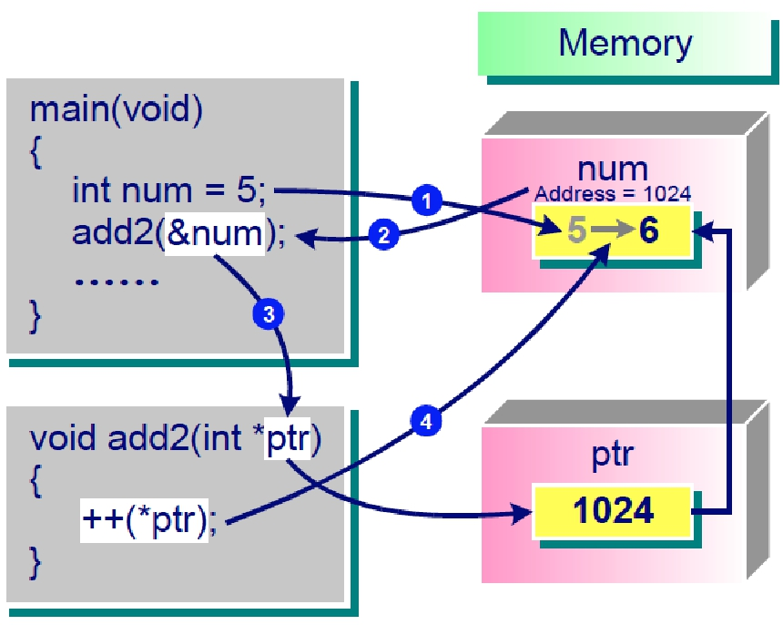
31

Slide 32
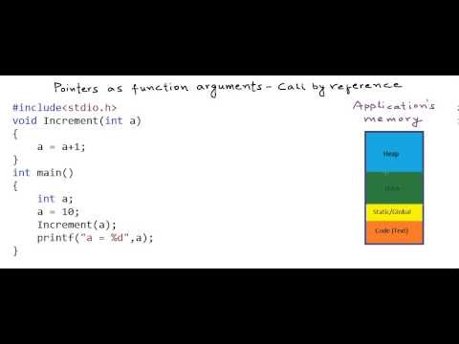
Pointers as function arguments
https://www.youtube.com/watch?v=LW8Rfh6TzGg&index=5&list=PL2_aWCzGMAwLZp6LMUKI3cc7pgGsasm2_
 Swinburne University of Technology
32

Slide 33
When to use call by reference?
■
■
Need to pass more than one value back from a
function
Or if using call by value will result in a large piece
of information being copied to the formal parameter
(for efficiency)
Call by reference saves a lot of memory – creating a copy of complex data type we can just use a reference to it
■
 Swinburne University of Technology
33

Slide 34
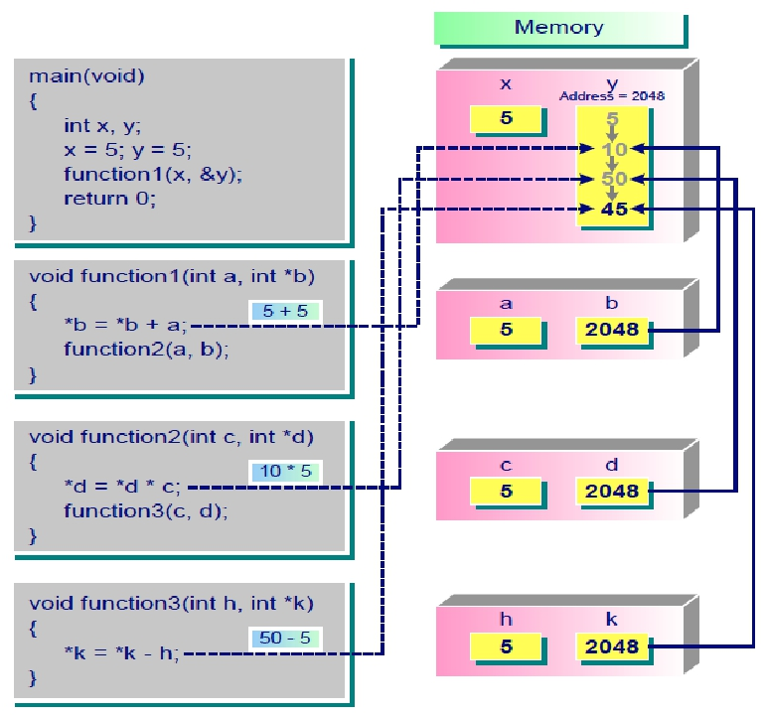
Example: A hybrid function call
34

Slide 35
Thank you
35

